Slide 1


Next Up:
Justin Grote

Slide 2
3
3

Slide 3
2

Slide 4
1

Slide 5
Optimizing Visual Studio Code for PowerShell 2025 Edition
Justin Grote

Slide 6

Many thanks to our sponsors:

Slide 7
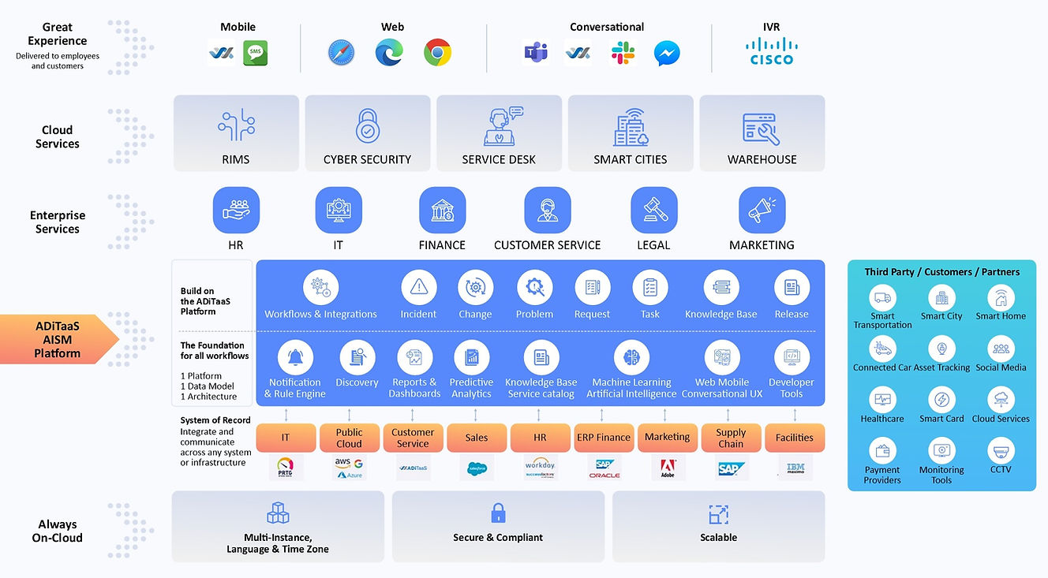

Thank you Allied Digital!

Slide 8


Justin Grote
Datacenter Solutions Architect Allied Digital Services LLC
4x Microsoft MVP
PowerShell VSCode, Pester VSCode, PowerHTML, ModuleFast, SecretManagement, PoshNMAP, IPNetwork, Press, etc.
Session Content

Slide 9




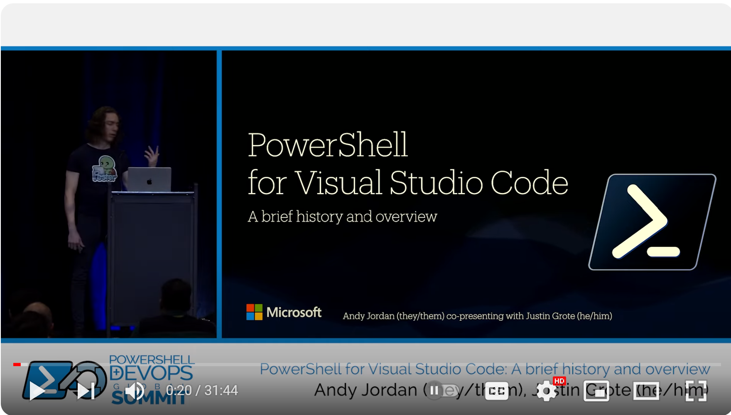
Previously…

Slide 10
Session Content

Slide 11
References
Visual Studio Code Updates Log
PowerShell for VSCode CHANGELOG
VSCode Youtube Channel (and shorts!)
Code 2020

Slide 12
Q&A
15 minutes
Session Content

